Slide 1
Psoriatic Arthritis
Literature Highlights
April 2023

Slide 2
Multidomain Efficacy and Safety of Guselkumab Through 1 Year in Patients With Active Psoriatic Arthritis With and Without Prior Tumor Necrosis Factor Inhibitor Experience: Analysis of the Phase 3, Randomized, Placebo-Controlled DISCOVER-1 Study Ritchlin, et al.
Full slide deck available!
TNF inhibition is the main mode of therapy in patients with PsA who fail to respond to csDMARDs.
Guselkumab demonstrated efficacy with a favourable safety profile in reducing the signs and symptoms of active PsA in DISCOVER-1 & 2
Previous publications have suggested that guselkumab is efficacious in both TNF inhibitor exposed and naïve populations¹
The objective of this study was to evaluate efficacy and safety of guselkumab in DISCOVER-1 patients with active PsA by prior use of TNFi
Treatment with 100 mg of guselkumab Q4W and Q8W resulted in improvements in multiple domains of PsA
These improvements were maintained through 1 year in both TNFi-naive and TNFi-experienced populations
A consistent and positive safety profile was observed in both TNFi populations and was consistent with the guselkumab safety profile established for PsA and psoriasis
TNFi-naive patients were more likely to achieve end points related to pain than TNFi-experienced patients

Slide 3
Efficacy of Secukinumab on Dactylitis in Patients with Active Psoriatic Arthritis from the FUTURE 5 study Kirkham, et al.
Full slide deck available!
Dactylitis is a characteristic musculoskeletal lesion of PsA
The recent GRAPPA recommendations recognise dactylitis as a key domain that reflects higher disease burden and necessitates early diagnosis, assessment, and treatment in PsA
In the FUTURE 5 study, secukinumab with and without loading regimen provided sustained clinical efficacy and low radiographic progression over 2 years in patients with PsA
The aim of this study was to evaluate the efficacy of secukinumab in patients with dactylitis at baseline over 2 years
The presence of dactylitis was associated with a higher disease burden in patients with PsA compared with those without dactylitis at baseline
This analysis extends the evidence for the early and sustained efficacy of secukinumab on dactylitis
This was irrespective of severity and comprehensive efficacy across other PsA domains, low radiographic progression, improvement of function, and HRQoL to the same extent as patients without dactylitis
Resolution of dactylitis was observed across all treatment groups at Week 104

Slide 4
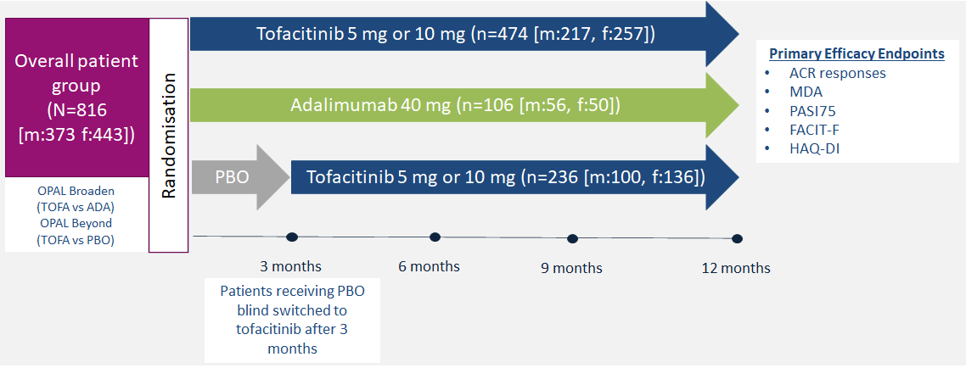
Sex Differences in the Efficacy, Safety and Persistence of Patients with Psoriatic Arthritis Treated with Tofacitinib: A Post Hoc Analysis of Phase 3 Trials and Long-Term Extension Eder L, et al.
Full slide deck available!
The impact of sex on tofacitinib treatments has not previously been reported in patients with PsA
This post hoc analysis of phase 3 RCT data of tofacitinib in PsA evaluates the impact of sex on the efficacy, safety and persistence in patients with PsA
Tofacitinib proved effective in both sexes, however, females were less likely to achieve MDA than males, highlighting the need for further study into the influence of sex in disease and therapy responses

Slide 5
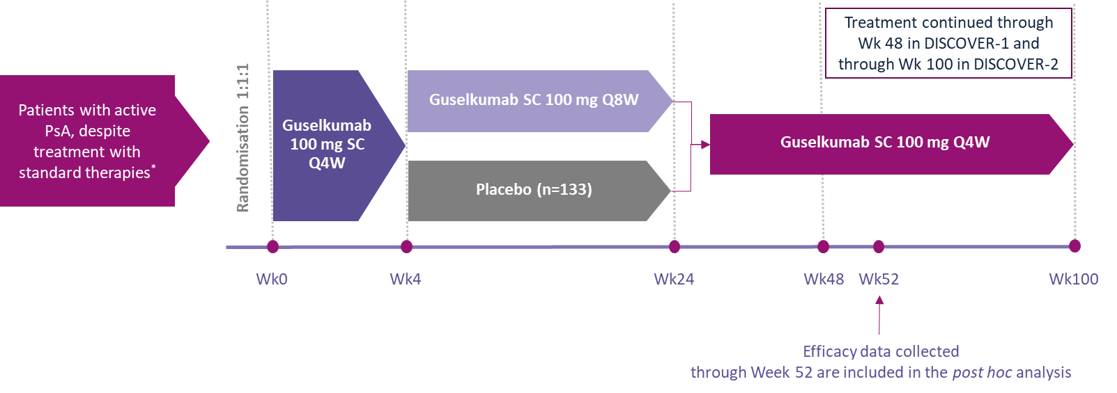
Guselkumab, a Selective Interleukin-23 p19 Subunit Inhibitor, Resolves Dactylitis in Patients with Active Psoriatic Arthritis: Pooled Results Through Week 52 From Two Phase 3 Studies McGonagle, et al
Full slide deck available!
Guselkumab, targets the p19 subunit of IL-23, was approved for the treatment of moderate-severe PsO and PsA
This post hoc analysis aimed to investigate specific treatment effects of guselkumab through 1 year in patients with PsA, with and without dactylitis
At Week 52, approximately 75% of guselkumab-randomized patients with dactylitis at baseline had complete resolution; approximately 80% had at least 70% DSS improvement

Slide 6
Association Between Biological Immunotherapy for Psoriasis and Time to Incident Inflammatory Arthritis: A Retrospective Cohort Study Singla, et al.
Full slide deck available!
There is a need to identify strategies for preventing progression from PsO to PsA, of which bDMARDs are of interest
This retrospective cohort study compared the risk of PsO patients developing inflammatory arthritis, including PsA
*
57862 patients
with PsO
15501 adult patients included in the primary analysis
Primary outcome
Prescribed biologics†
TNFi
IL-17i
IL-23i
IL-12/23i
Time to incident
inflammatory arthritis
(First occurrence of any diagnostic code for inflammatory arthritis (PsA or other inflammatory arthritis) starting 2 weeks after
the index date)
PsO patients treated with IL-12/23i had a reduced risk of progression to PsA compared to patients treated with TNFi

Slide 7
Apremilast for Biologic‑naïve, Peripheral Psoriatic Arthritis, Including Patients with Early Disease: Results from the APROACH Observational Prospective Study Sfikakis, et al.
Apremilast has demonstrated clinical efficacy accompanied by a favourable safety and tolerability profile in the product’s clinical trial program across a wide spectrum of PsA patient profiles
The target of PsA therapy is achievement of remission or low disease activity according to composite indices
The aim of this investigation was to evaluate the effect of apremilast in biologic-naïve patients with early peripheral PsA in routine care settings of Greece
Apremilast was associated with rapid and sustained improvements in all aspects of psoriatic disease manifestations when initiated early in the patient journey
Apremilast demonstrated high drug survival and a safety profile consistent with the product’s label
N=116
Apremilast was associated with rapid and sustained improvements in all aspects of psoriatic disease manifestations when initiated early in the patient journey

